Slide 1
Transport Layer
CN#4

Slide 2
Transport Layer: Introduction
The transport layer is located between the network layer and the application layer. The transport layer is responsible for providing services to the application layer; it receives services from the network layer.
The transport layer, ensures that the whole message arrives intact and in order, overseeing both error control and flow control at the source-to-destination level.
The transport layer is responsible for the delivery of a message from one process to another.

Slide 3
Type of Services
A transport layer protocol can either be connectionless or connection-oriented.
Connectionless Service
In a connectionless service, the packets are sent from one party to another with no need for connection establishment or connection release. The packets are not numbered; they may be delayed or lost or may arrive out of sequence. There is no acknowledgment either. UDP, is connectionless.
Connection Oriented Service
In a connection-oriented service, a connection is first established between the sender and the receiver. Data are transferred. At the end, the connection is released.

Slide 4
USER DATAGRAM PROTOCOL (UDP)
The User Datagram Protocol (UDP) is called a connectionless, unreliable transport protocol. It does not add anything to the services of IP except to provide process-to­ process communication instead of host-to-host communication. Also, it performs very limited error checking.
Why UDP?
UDP is a very simple protocol using a minimum of overhead. If a process wants to send a small message and does not care much about reliability, it can use UDP. Sending a small message by using UDP takes much less interaction between the sender and receiver than using TCP.

Slide 5
TCP
Transmission Control Protocol (TCP): TCP, like UDP, is a process-to-process (program-to-program) protocol. TCP, uses port numbers. Unlike UDP, TCP is a connection­ oriented protocol; it creates a virtual connection between two TCPs to send data. In addition, TCP uses flow and error control mechanisms at the transport level. These two fields refer to the byte number and not the segment number.
TCP Features:
Numbering System: TCP software keeps track of the segments being transmitted or received, there are two fields called the sequence number and the acknowledgment number. These two fields refer to the byte number and not the segment number. The numbering does not necessarily start from O. Instead, TCP generates a random number between 0 and for the num­ber of the first byte.
The bytes of data being transferred in each connection are numbered by TCP. The numbering starts with a randomly generated number.
For example, if the random number happens to be 1057 and the total data to be sent are 6000 bytes, the bytes are numbered from 1057 to 7056.

Slide 6
TCP Features
Sequence Number After the bytes have been numbered, TCP assigns a sequence number to each segment that is being sent. The sequence number for each segment is the number of the first byte carried in that segment.
Flow Control: TCP, unlike UDP, provides flow control. The receiver of the data controls the amount of data that are to be sent by the sender. This is done to prevent the receiver from being over­ whelmed with data. The numbering system allows TCP to use a byte-oriented flow control.
Error Control: To provide reliable service, TCP implements an error control mechanism. Although error control considers a segment as the unit of data for error detection (loss or corrupted segments), error control is byte-oriented.
Congestion Control: TCP, unlike UDP, takes into account congestion in the network. The amount of data sent by a sender is not only controlled by the receiver (flow control), but is also determined by the level of congestion in the network.

Slide 7
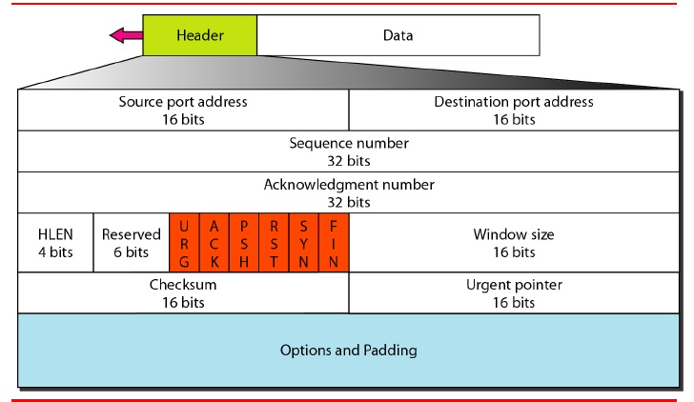
TCP Segment Format

Slide 8
Application Layer Protocol: HTTP runs on TCP
The transfer protocol used throughout the World Wide Web is HTTP (Hyper Text Transfer Protocol). TCP provides a reliable data transfer service to HTTP, using TCP port 80. This implies that each HTTP request message emitted by a client process eventually arrives in tact at the server; similarly, each HTTP response message emitted by the server process eventually arrives in tact at the client. HTTP need not worry about lost data, or the details of how TCP recovers from loss or reordering of data within the network. That is the job of TCP and the protocols in the lower layers of the protocol stack

Slide 9
Three-Way Handshaking
The three steps in this phase are as follows:
The client sends the first segment, a SYN segment, in which only the SYN flag is set. This segment is for synchronization of sequence numbers. It consumes one sequence number. When the data transfer starts, the sequence number is incremented by 1.
The server sends the second segment, a SYN + ACK segment, with 2 flag bits set: SYN and ACK. This segment has a dual purpose. It is a SYN segment for commu­nication in the other direction and serves as the acknowledgment for the SYN segment. It consumes one sequence number.
The client sends the third segment. This is just an ACK segment. It acknowledges the receipt of the second segment with the ACK flag and acknowledgment number field. Note that the sequence number in this segment is the same as the one in the SYN segment; the ACK segment does not consume any sequence numbers.

Slide 10
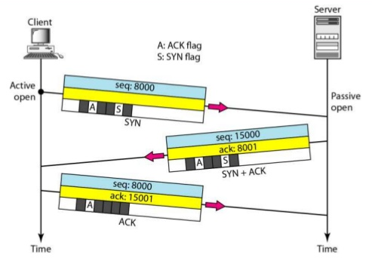
Three-Way Handshaking

Slide 11
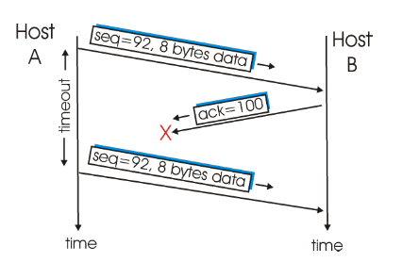
A Few Interesting Scenarios: lost acknowledgment
Host A sends one segment to host B.
Suppose that this segment has sequence number 55 and contains 5 bytes of data.
After sending this segment, host A waits for a segment from B with acknowledgment number 60. Although the segment from A is received at B, the acknowledgment from B to A gets lost.
In this case, the timer expires, and host A retransmits the same segment. Of course, when host B receives the retransmission, it will observe that the bytes in the segment duplicate bytes it has already deposited in its receive buffer.
Thus TCP in host B will discard the bytes in the retransmitted segment.
seq=55,5 bytes data
ack=60
seq=55,5 bytes data
Fig: Retransmission due to a lost acknowledgment

Slide 12
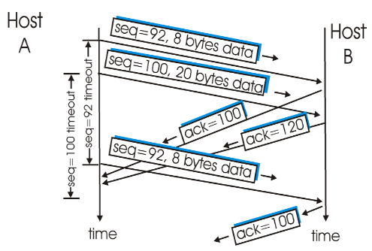
A Few Interesting Scenarios: acknowledgment arrives before the timeout
Host A sends two segments back to back. The first segment has sequence number 55 and 5 bytes of data, and the second segment has sequence number 60 and 20 bytes of data.
Suppose that both segments arrive intact at B, and B sends two separate acknowledgements (60, 80) for each of these segments.
Suppose now that neither of the acknowledgements arrive at host A before the timeout of the first segment.
When the timer expires, host A resends the first segment with sequence number 55.
Now host A resends the segment only if the timer expires before the arrival of an acknowledgment with an acknowledgment number of 80 or greater.
Thus, as shown in figure, if the second acknowledgment does not get lost and arrives before the timeout of the second segment, A does not resend the second segment.
seq=55,5 bytes data
seq=60,20 bytes data
=55 timeout
=60 timeout
ack = 60
ack = 80
seq=55,5 bytes data
ack = 60
Fig: Segment is not retransmitted because
its acknowledgment arrives before the timeout.

Slide 13
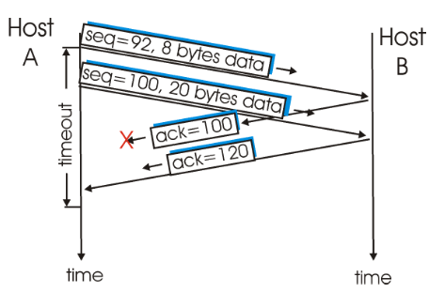
A Few Interesting Scenarios: cumulative acknowledgment
Host A sends the two segments, exactly as in the second example.
The acknowledgment of the first segment is lost in the network, but just before the timeout of the first segment, host A receives an acknowledgment with acknowledgment number 80.
Host A therefore knows that host B has received everything up through byte 79; so host A does not resend either of the two segments.
seq=55,5 bytes data
seq=60,20 bytes data
ack = 60
ack = 80
Fig: A cumulative acknowledgment avoids
retransmission of first segment

Slide 14
Congestion in network
What is Congestion:
An important issue in a packet-switched network is congestion. Congestion in a network may occur if the load on the network-the number of packets sent to the network-is greater than the capacity of the network-the number of packets a network can handle. Congestion control refers to the mechanisms and techniques to control the congestion and keep the load below the capacity.
Congestion Occurrence:
Congestion in a network or internetwork occurs because routers and switches have queues-buffers that hold the packets before and after processing. A router, for example, Has an input queue and an output queue for each interface. When a packet arrives at the incoming interface, it undergoes three steps before departing, as shown in Figure

Slide 15
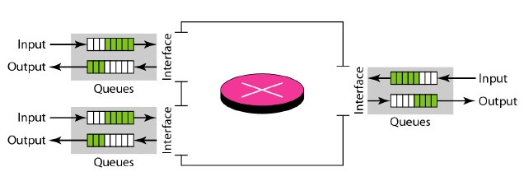
Congestion in network
1. The packet is put at the end of the input queue while waiting to be checked.
2. The processing module of the router removes the packet from the input queue once it reaches the front of the queue and uses its routing table and the destination address to find the route.
3. The packet is put in the appropriate output queue and waits its tum to be sent.
We need to be aware of two issues. First, if the rate of packet arrival is higher than the
packet processing rate, the input queues become longer and longer. Second, if the packet
departure rate is less than the packet processing rate, the output queues become longer
and longer

